Slide 1
Capstone Project
Predicting Movie Success

Slide 2

Predicting Movie Success
Project Goal :
Develop a comprehensive data analysis pipeline and a robust machine learning model to accurately predict movie success categories (Hit, Average, Flop) based on various movie attributes. By utilizing this model, the studio aims to improve movie production decisions, marketing strategies, and overall film industry insights.

Slide 3
Agenda
Introduction
Methodology
Data Gathering
Exploratory Data Analysis (EDA)
Model Selection
Model Evaluation
Cross-Validation & Hyperparameter Tuning
Conclusion

Slide 4
Introduction :
The movie industry is a multi-billion-dollar global business, yet it remains one of the most unpredictable. Many factors contribute to a film's success, including budget, cast, director, genre, and even timing of release. With the increasing availability of data and advancements in machine learning, predicting movie success has become a valuable application of data science.
Introduction: Our client, a major film studio, aims to enhance their understanding of factors influencing movie success and improve prediction models for IMDB ratings. They want to leverage advanced data analysis techniques and machine learning to analyze movie characteristics and predict whether a movie will be a hit, average, or flop based on IMDB scores.
By training machine learning models on historical data, we can identify patterns and factors that correlate strongly with success. These models can then be used by production companies, investors, or streaming platforms to make informed decisions.

Slide 5
Common Features Used in Prediction :
Budget
Duration
Genres
Gross
Director/actor popularity (e.g., Facebook likes)
IMDB score
Number of voted users
Title year
Language
Country
Number of critic for reviews

Slide 6
Work Flow
1. Data Collection
4. Model Selection & Model Training
5. Model Evaluation
2. EDA
3. Preprocessing

Slide 7
Methodology :
Load and explore the dataset using pandas, matplotlib, and seaborn.
Preprocess the data, including handling missing values, label encoding, and addressing multicollinearity.
Implement feature selection.
Split the data into training and testing sets, and apply feature scaling.
Train and evaluate a Random Forest classifier for predicting movie success categories.
Generate and interpret performance metrics and visualizations.

Slide 8
Data Collection :
The dataset contains 28 variables for 5043 movies, spanning across 100 years in 66 countries. There are 2399 unique director names, and thousands of actors/actresses. “imdb_score” is the response variable while the other 27 variables are possible predictors.
After importing the dataset we check the shape and the description of the dataset.
The original dataset has 5043 rows and 28 columns.
Check the data type of each column.
dtypes : float64(13), int64(3), object(12)

Slide 9
Dataset Overview :
Variable Name | Description
movie_title | Title of the Movie
duration | Duration in minutes
director_name | Name of the Director of the Movie
director_facebook_likes | Number of likes of the Director on his Facebook Page
actor_1_name | Primary actor starring in the movie
actor_1_facebook_likes | Number of likes of the Actor_1 on his/her Facebook Page
actor_2_name | Other actor starring in the movie
actor_2_facebook_likes | Number of likes of the Actor_2 on his/her Facebook Page
actor_3_name | Other actor starring in the movie
actor_3_facebook_likes | Number of likes of the Actor_3 on his/her Facebook Page
num_user_for_reviews | Number of users who gave a review
num_critic_for_reviews | Number of critical reviews on imdb
num_voted_users | Number of people who voted for the movie
cast_total_facebook_likes | Total number of facebook likes of the entire cast of the movie
movie_facebook_likes | Number of Facebook likes in the movie page
plot_keywords | Keywords describing the movie plot
facenumber_in_poster | Number of the actor who featured in the movie poster
color | Film colorization. ‘Black and White’ or ‘Color’
genres | Film categorization like ‘Animation’, ‘Comedy’, ‘Romance’, ‘Horror’, ‘Sci-Fi’, ‘Action’, ‘Family’
title_year | The year in which the movie is released (1916:2016)
language | English, Arabic, Chinese, French, German, Danish, Italian, Japanese etc
country | Country where the movie is produced
content_rating | Content rating of the movie
aspect_ratio | Aspect ratio the movie was made in
movie_imdb_link | IMDB link of the movie
gross | Gross earnings of the movie in Dollars
budget | Budget of the movie in Dollars
imdb_score | IMDB Score of the movie on IMDB

Slide 10
Data Preprocessing :
Handling Missing Values.
Outliers Treatment: Checked outliers using IQR method for the continuous features and replaced NaNs with median.
Irrelevant Feature Removal.
Encoding Categorical Features (e.g., Label Encoding).
Normalizing/Standardizing Numerical Values.
Feature Engineering.

Slide 11

EXPLORATORY DATA ANALYSIS
Exploratory Data Analysis (EDA) helped us understand the data structure, find patterns, identify trends, and gain valuable insights from the dataset.
From EDA we analyze, the distribution of each features, checking the correlation between the features .
Using visuals helped us see the data clearly, understand the clinical data relationship with each other, and pinpoint factors that plays vital role in predictions of movie success.
There are few NULL VALUE, we find some DUPLICATE VALUES and OUTLIERS.
We looked at our data columns and found few columns to be numerical in terms of data types, but they are categorical in terms of semantic. So, we converted them to object for proper analysis.

Slide 12
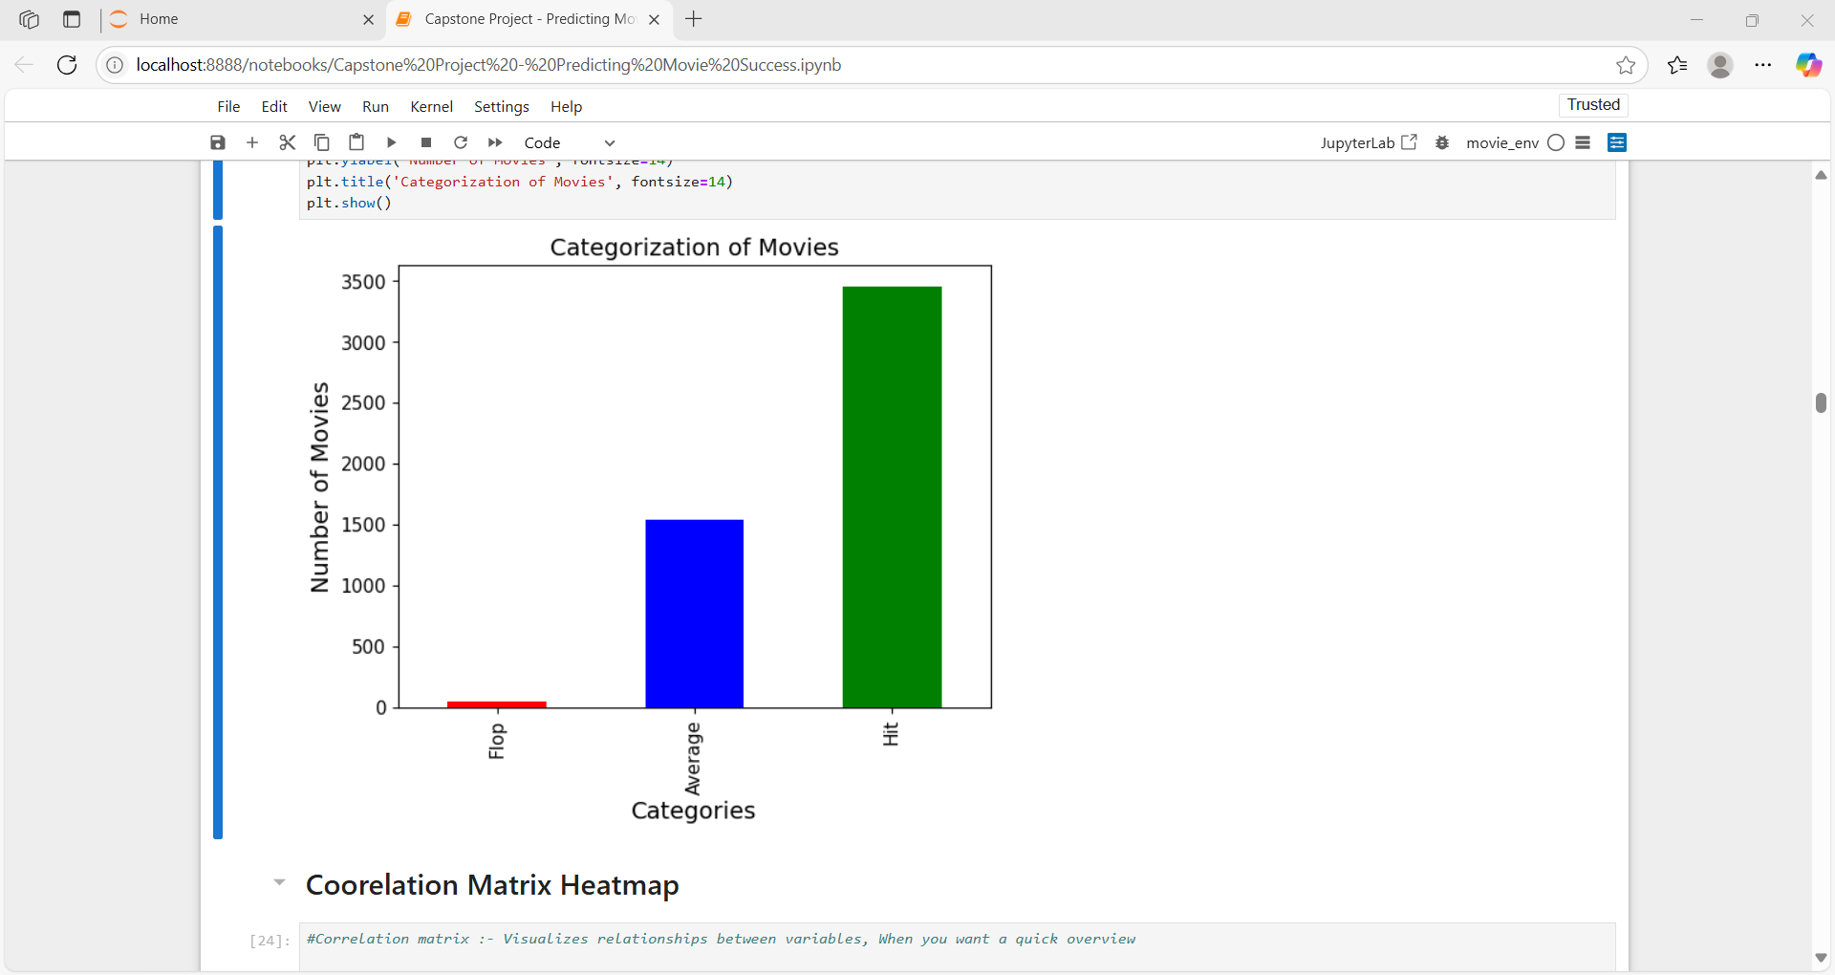
Data Exploration
“Distribution of Movie Categories”
Categorize IMDB Scores: Create a new column Classify to categorize movies into "Hit", "Average", or "Flop" based on the IMDB score ranges(|1-3 | -Flop Movie,|3-6 |- Average Movie,|6-10 |- Hit Movie)
Flop: Very few movies are classified as flops.
Average: A moderate number of movies fall in this category.
Hit: A large number of movies are classified as hits — around 3500 based on the bar height.
“Majority of the movies in the dataset are classified as hits, while very few are flops. This class imbalance should be considered during model training.”

Slide 13
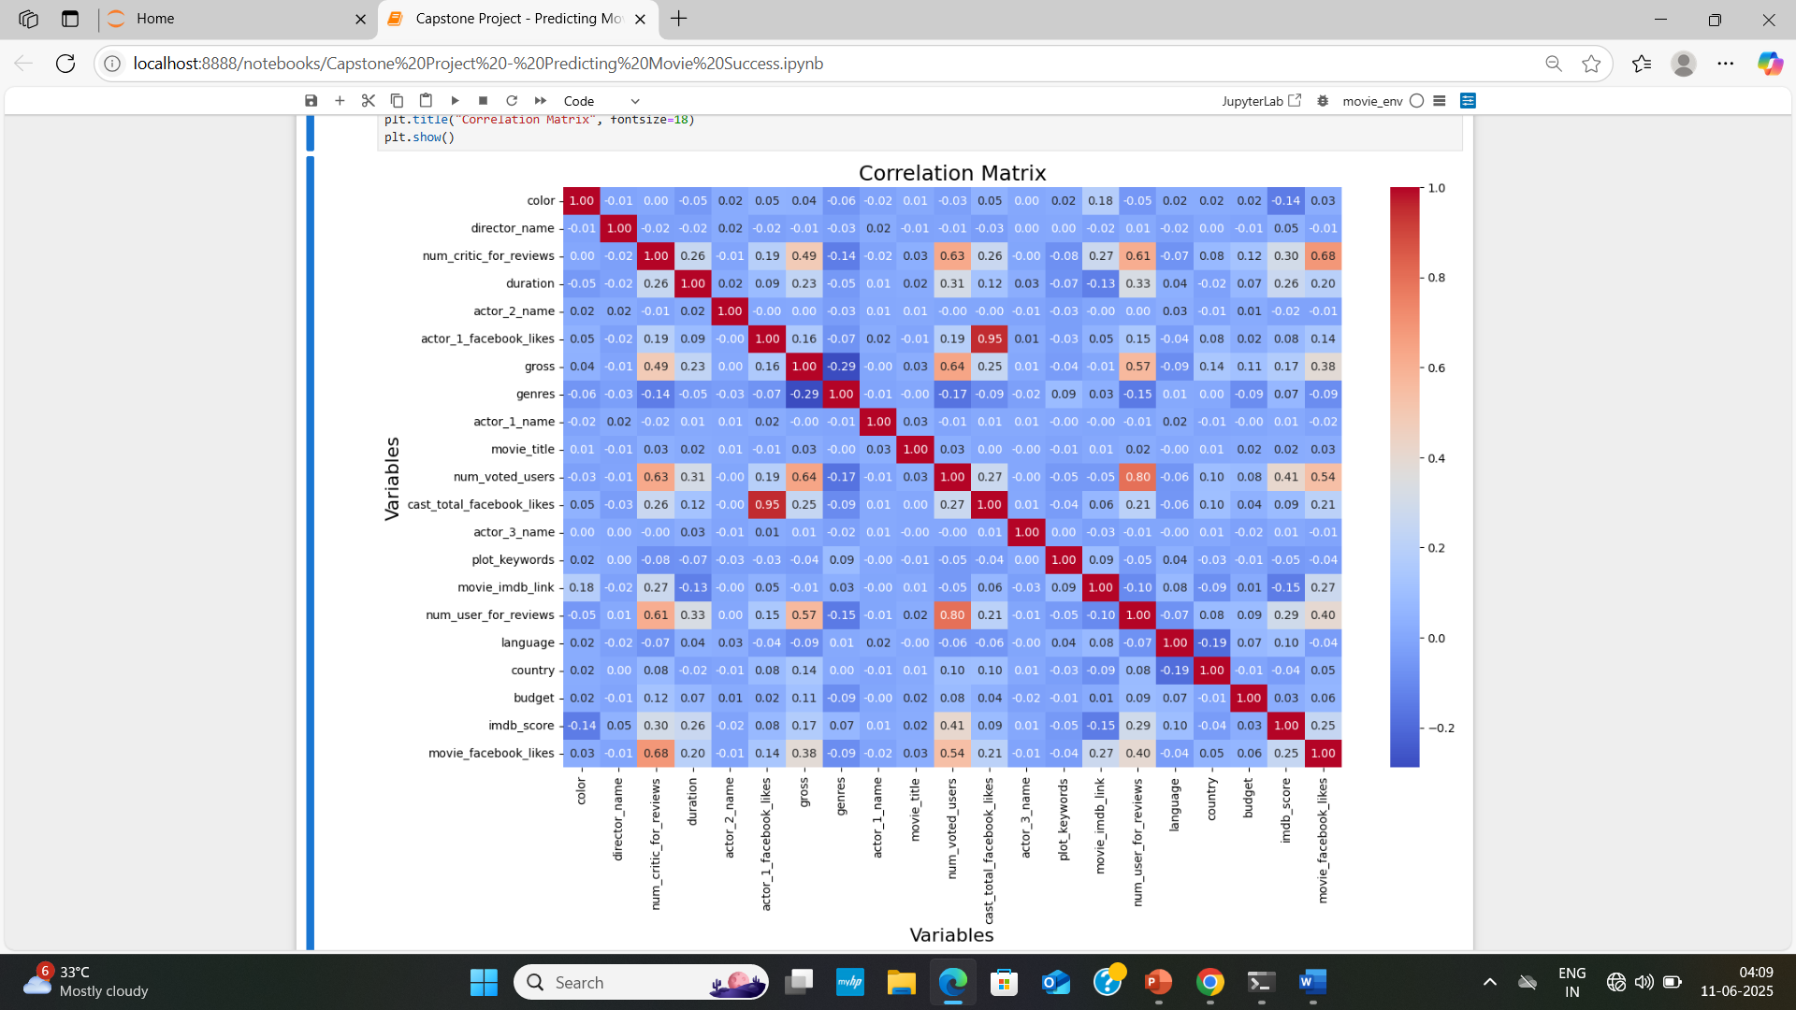
CORRELATION HEATMAP
What is a Correlation Matrix? It's a table showing correlation coefficients between variables. Each cell shows how strongly two variables are linearly related.
Correlation coefficient r ranges from : +1 (perfect positive correlation) 0 (no correlation) –1 (perfect negative correlation)
Diagonal (top-left to bottom-right) : Always 1.0 — each variable is perfectly correlated with itself.
Strong Positive Correlations :
Feature 1 Feature 2 Correlation Interpretation
actor_1_facebook_likes cast_total_facebook_likes 0.95 Actor 1's likes are a major part of total cast likes

Slide 14
num_user_for_reviews num_critic_for_reviews 0.61 Movies with more critic reviews also get more user reviews movie_facebook_likes cast_total_facebook_likes 0.54 Popular casts help a movie get Facebook likes num_user_for_reviews imdb_score 0.50 More user reviews may reflect better ratings budget gross 0.57 Higher budget movies often earn more revenue
Weak or No Correlation :
Feature 1 Feature 2 Value Range genres Most variables ≈ 0 movie_title Anything ≈ 0
plot_keywords Most features ≈ 0
This heatmap reveals which variables are strongly correlated, helping us to choose the best features.
We should consider removing one of any pair with correlation > 0.9 to avoid multicollinearity.
Use this info to refine feature selection for models like Random Forest, Decision Trees, etc.

Slide 15
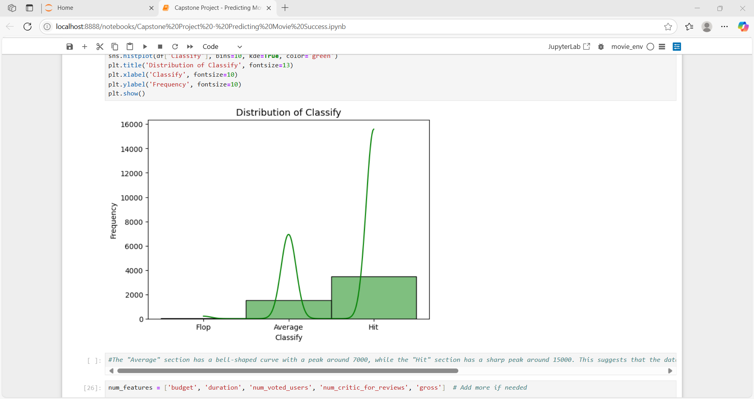
Distribution Plot :
The "Average" section has a bell-shaped curve with a peak around 7000, while the "Hit" section has a sharp peak around 15000. This suggests that the data is bimodal, with two distinct groups of values. The "Flop" section has a very low frequency.
KDE Curve (Bell-Shaped Line): Attempts to estimate the probability density of the data — more commonly used with continuous variables.
This suggests that most movies in our dataset were classified as "Hit".

Slide 16
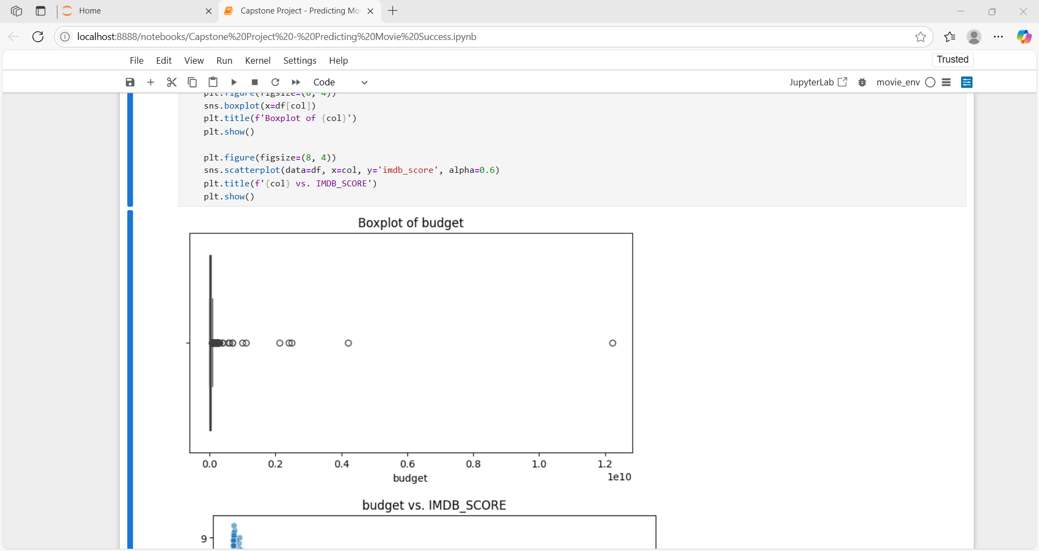
Visuals : Boxplots And Scatter Plots
Heavy concentration at lower end - Almost all the data is very tightly packed near 0, suggesting most movies had low budgets.
The black box (IQR) is near the left (low values), showing that 50% of the data lies in this small budget range.
Many outliers - The dots on the right side represent outliers — movies with much higher budgets. Some budgets go as high as 1.2e10 (or 12 billion, likely a data entry error — possibly a misplaced comma or extra zeros).
Skewed distribution - The plot is highly right-skewed (positive skew). A long tail and outliers to the right suggest a few very high-budget movies pull the mean up, while most budgets are low.

Slide 17
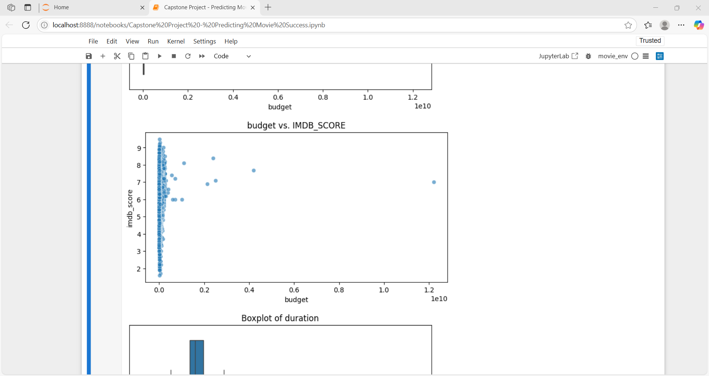
Budget vs. IMDB_Score
High concentration near the origin - Almost all dots are tightly packed in the very low budget range (close to 0).
Scattered high-budget movies - There are a few movies with very high budgets (e.g. 1.2e10, or 12 billion, on the far right), and they appear spread out in terms of IMDb scores. These do not consistently get higher IMDb scores, meaning a bigger budget doesn’t guarantee better ratings.
No strong visible correlation - There is no clear linear pattern — the dots do not form a clear upward or downward slope. This suggests weak or no correlation between budget and IMDb score.

Slide 18
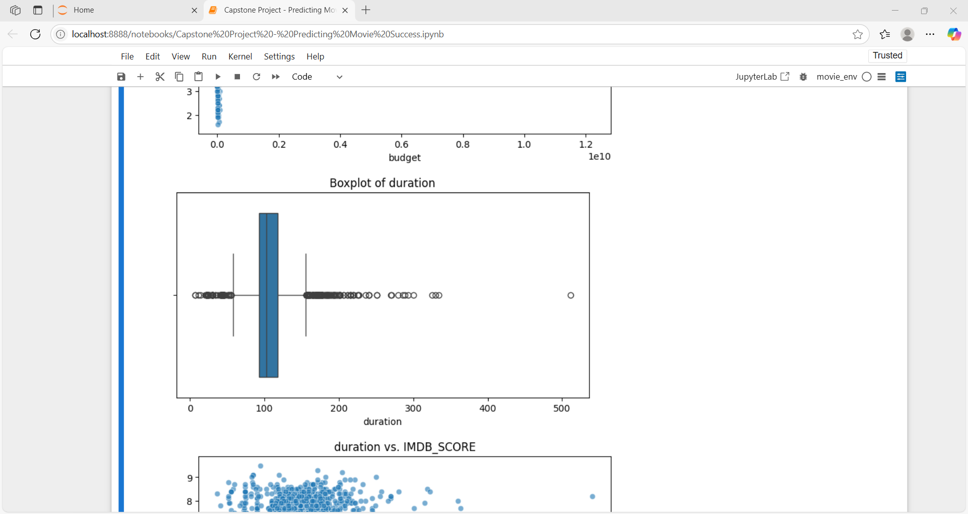
Boxplot of Duration
The Box (IQR) - This box shows the middle 50% of the movie durations.
Left edge of the box = Q1 (25th percentile)
Right edge of the box = Q3 (75th percentile)
A majority of movie durations fall within this range.
The Line Inside the Box (Median) - This vertical line inside the box = median (50th percentile). This tells you the typical movie length. In our case, the median is around 100 minutes, which makes sense for most movies.
The Dots (Outliers) - These are durations that are unusually short or long. We can see: Some movies with very short durations (<50 min), Some movies with very long durations, even >500 min (likely incorrect or extremely rare cases like extended series/multiple parts).

Slide 19
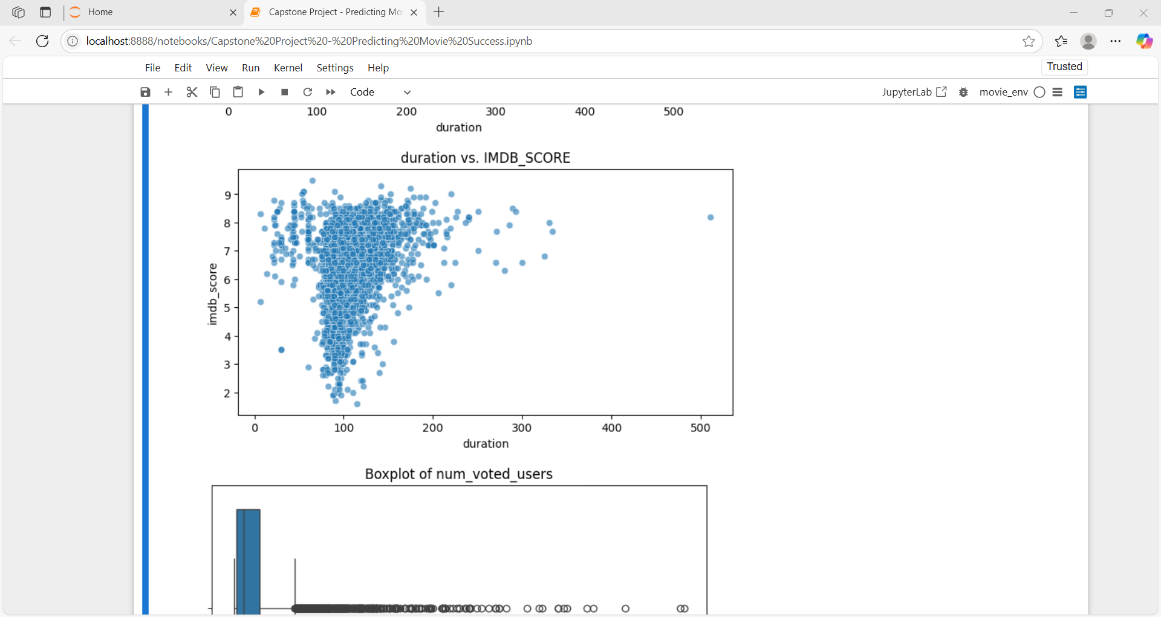
Duration vs. IMDB_Score
Movie Duration Clusters Between 80–140 Minutes. Most movies fall in the range of 80 to 140 Minutes.
IMDB Scores Are Spread Between 5 and 8 - The majority of IMDb scores are between 5.0 and 8.0, regardless of movie length. This means most movies are rated in this average-to-good range.
No Strong Correlation - The dots are fairly evenly spread out vertically at most durations. There's no clear upward or downward trend, which means: Longer movies do not necessarily get higher or lower IMDb ratings.
Outliers Exist - There are some very long movies (duration > 300 minutes, even near 500), but their IMDb scores are still average (around 6–7). These could be: Mini-series episodes combined, Incorrect data or Extremely rare long films.
High-density Region - The densest area is between: duration of 90–130 minutes, IMDB_SCORE of 6–8. So, most movies are of average length and have average IMDb scores.

Slide 20
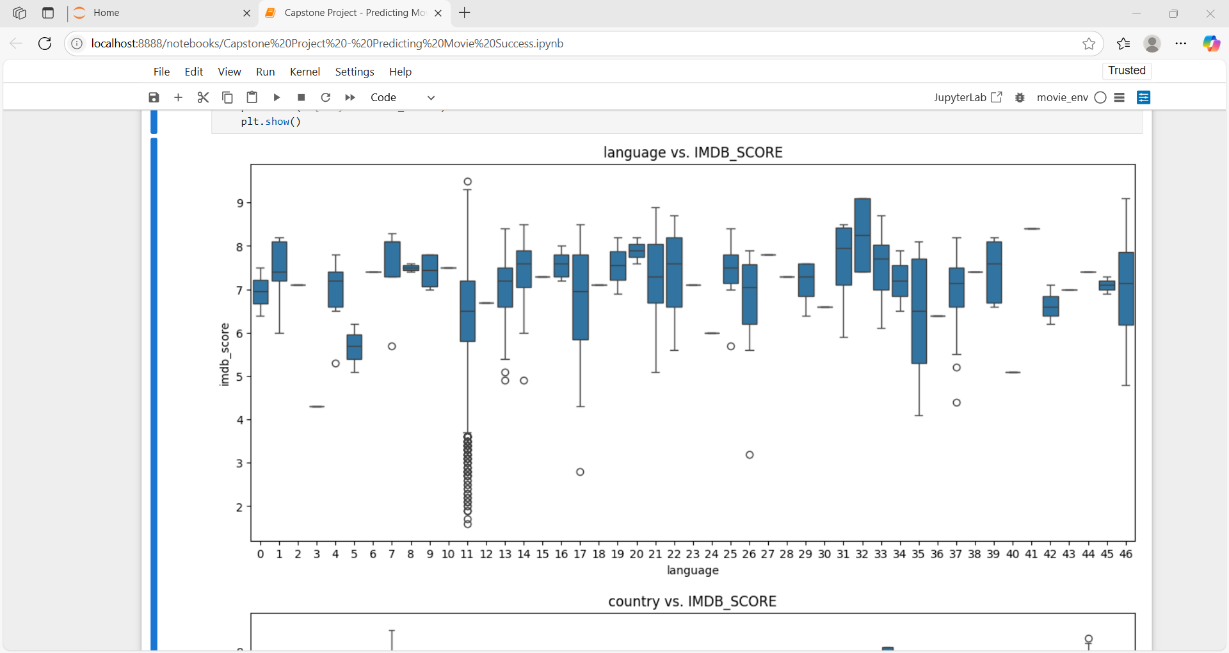
Language vs. IMDB_Score
Each box : shows the distribution of IMDb scores for movies in a particular language.
Most languages cluster around IMDb scores between 6 and 8, which is normal for typical movie ratings.
Language 11 (X-axis position 11) has a wide spread with many low outliers (scores as low as ~1.5) — this could indicate low-quality or niche movies in that language.
Languages at positions 0, 1, 6, and 30+ tend to have higher medians, suggesting movies in those languages often receive higher ratings.
Some languages have very few data points (narrow box or just one horizontal line), which might skew interpretation.

Slide 21
TRAIN TEST SPLIT
We divided the data into training (80%) and testing (20%) sets.
Setting a random state ensures consistent results and using stratify=y maintains a proportional distribution of the target variable in both sets.
SPLITING THE DATA INTO X & Y
We divided the dataset into two parts: X and y.
"X" typically represents the independent Variables, and "y" represents the Dependent (target variable) that we want to predict or understand.

Slide 22
MODEL SELECTION
Models used :
Random Forest Algorithm: Random Forest: Random Forest is a robust supervised algorithm suitable for both regression and classification tasks.
Decision Tree: Decision Tree algorithms are used for classification because they are simple, computationally efficient, and effective in handling high-dimensional data. Works best for categorical independent columns.
Logistic Regression: logistic Regression is commonly used for binary classification problems. It's preferred because it provides a simple an efficient way to model the relationship between the independent variables and the probability of a certain outcome.

Slide 23
Model Evaluation
Accuracy
Precision
Recall
F1- Score
Random Forest Classifier | 80 | 74 | 58 | 65
Decision Tree | 72 | 55 | 56 | 56
Logistic Regression | 72 | 57 | 36 | 44

Slide 24
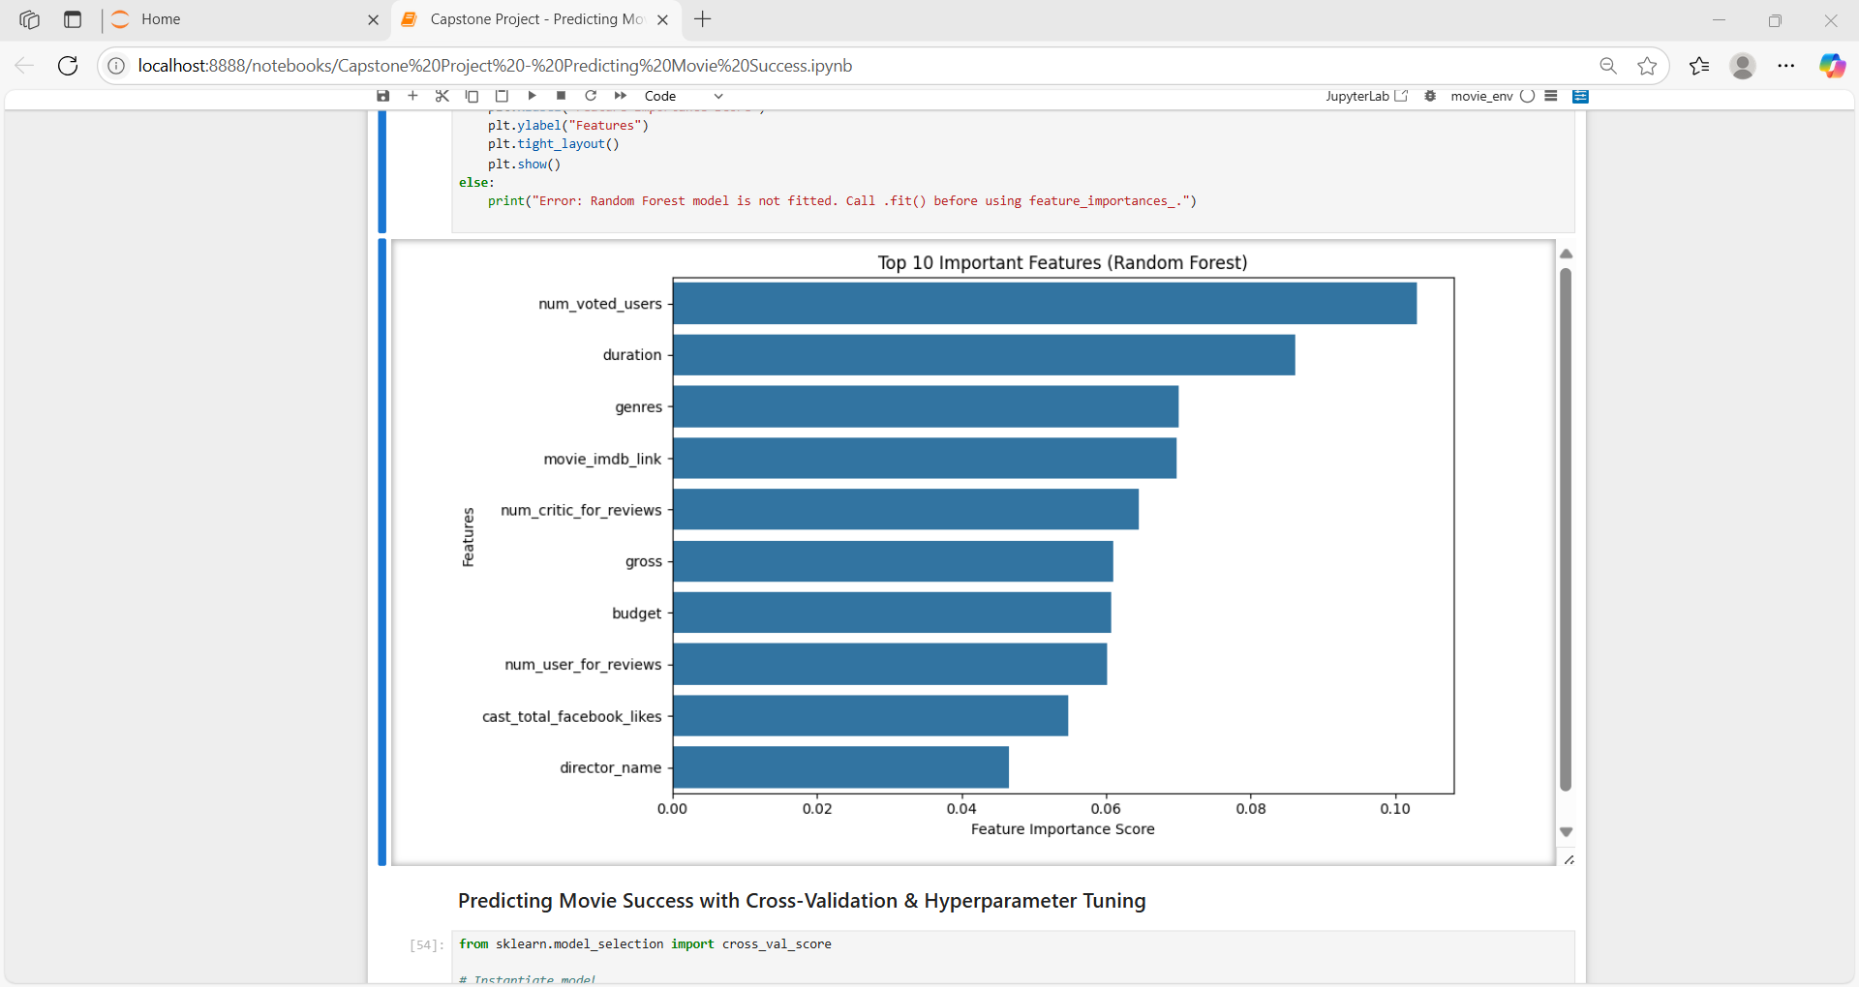
Feature Importance :

Slide 25
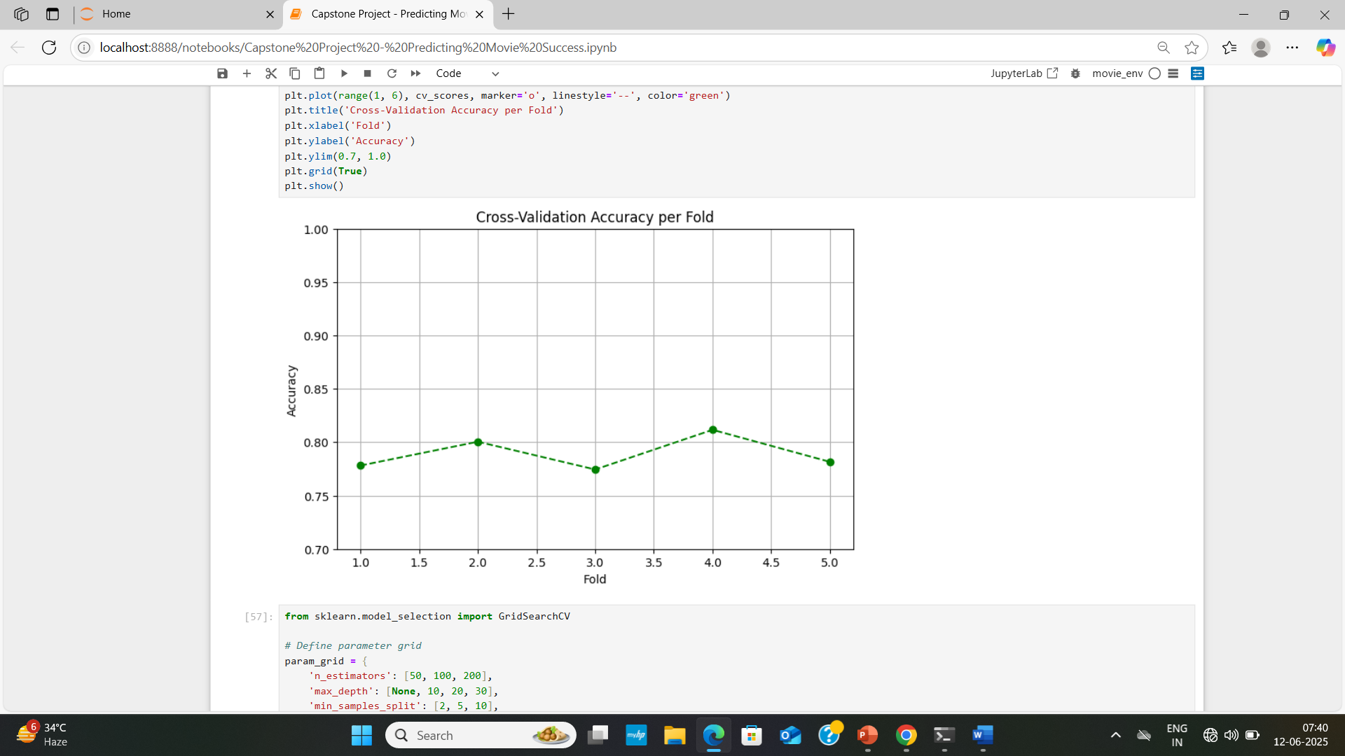
Cross-Validation :
X-axis(Fold):Represents the fold number in K-Fold Cross-Validation. In this case, 5 folds were used.
Y-axis(Accuracy):Represents the model’s accuracy score on each fold.
Dotted Line: Connects accuracy scores from each fold to visualize performance consistency.
The accuracy varies slightly between folds, staying between 0.78 and 0.82.
The performance is relatively stable, which is a good sign that the model is not overfitting.
Fold 4 gave the best accuracy, while others are quite close—suggesting that the model's performance is fairly consistent.

Slide 26
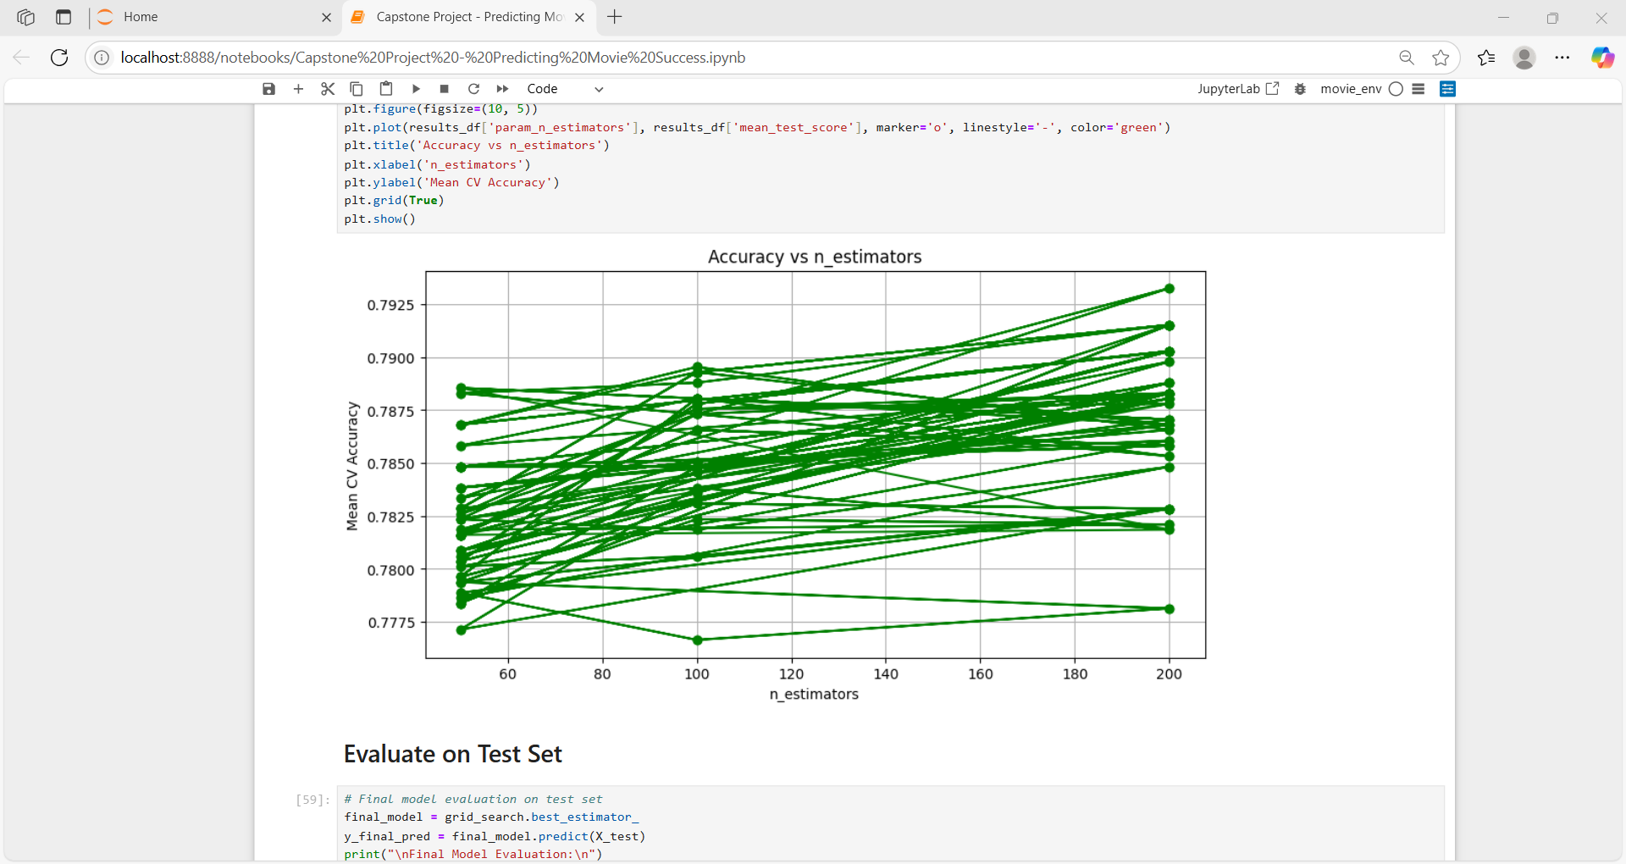
Hyperparameter Tuning :
X-axis (n_estimators): Number of trees used in the Random Forest model (ranging from ~50 to 200).
Y-axis (Mean CV Accuracy): The average accuracy obtained using cross-validation for each value of n_estimators.
Each line represents the change in CV accuracy for a specific parameter combination or run as n_estimators increases.
As n_estimators increases, the Mean CV Accuracy slightly improves.
Most lines have a gentle upward slope.
The best accuracy appears to be around n_estimators = 200, reaching close to 0.7925.

Slide 27
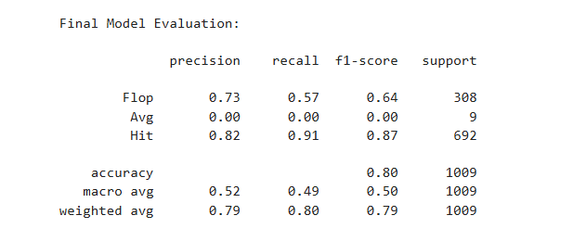
Experimental Results :
Final model evaluation on test set
Based on all the above metrics, graphs, and reports, I conclude that the Random Forest Classifier is the
most suitable machine learning model for predicting a movie success.

Slide 28
Conclusion :
Predicting movie success is a complex but feasible task using ML.
Helps investors and producers make data-driven decisions.
With more advanced models and richer datasets, accuracy can be improved.

Slide 29
Model Deployment

Slide 30
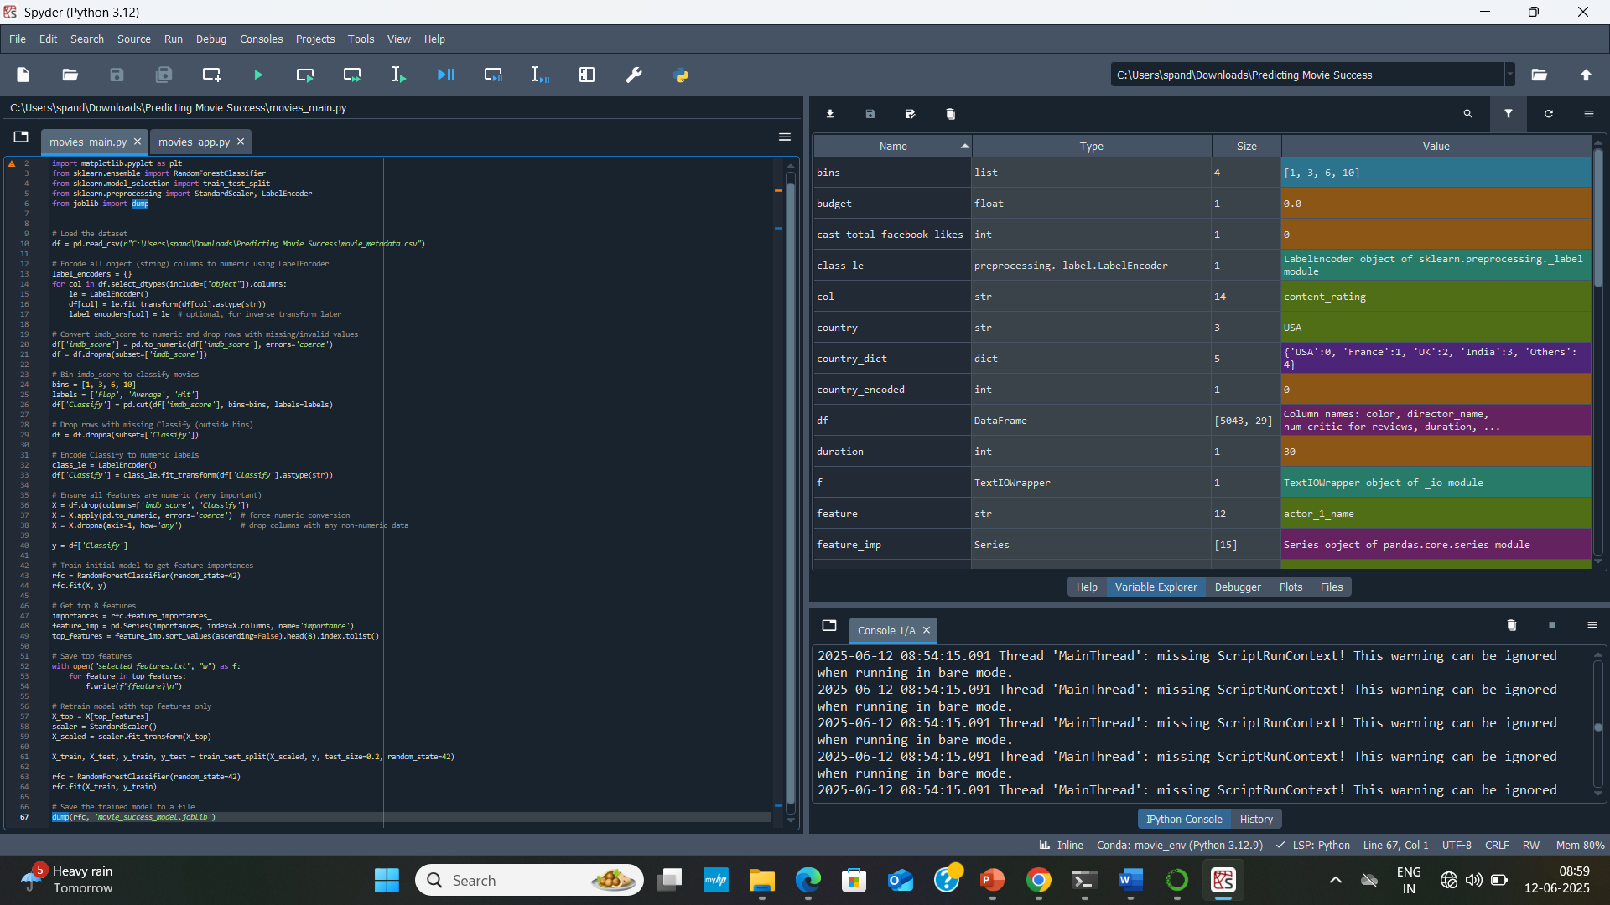
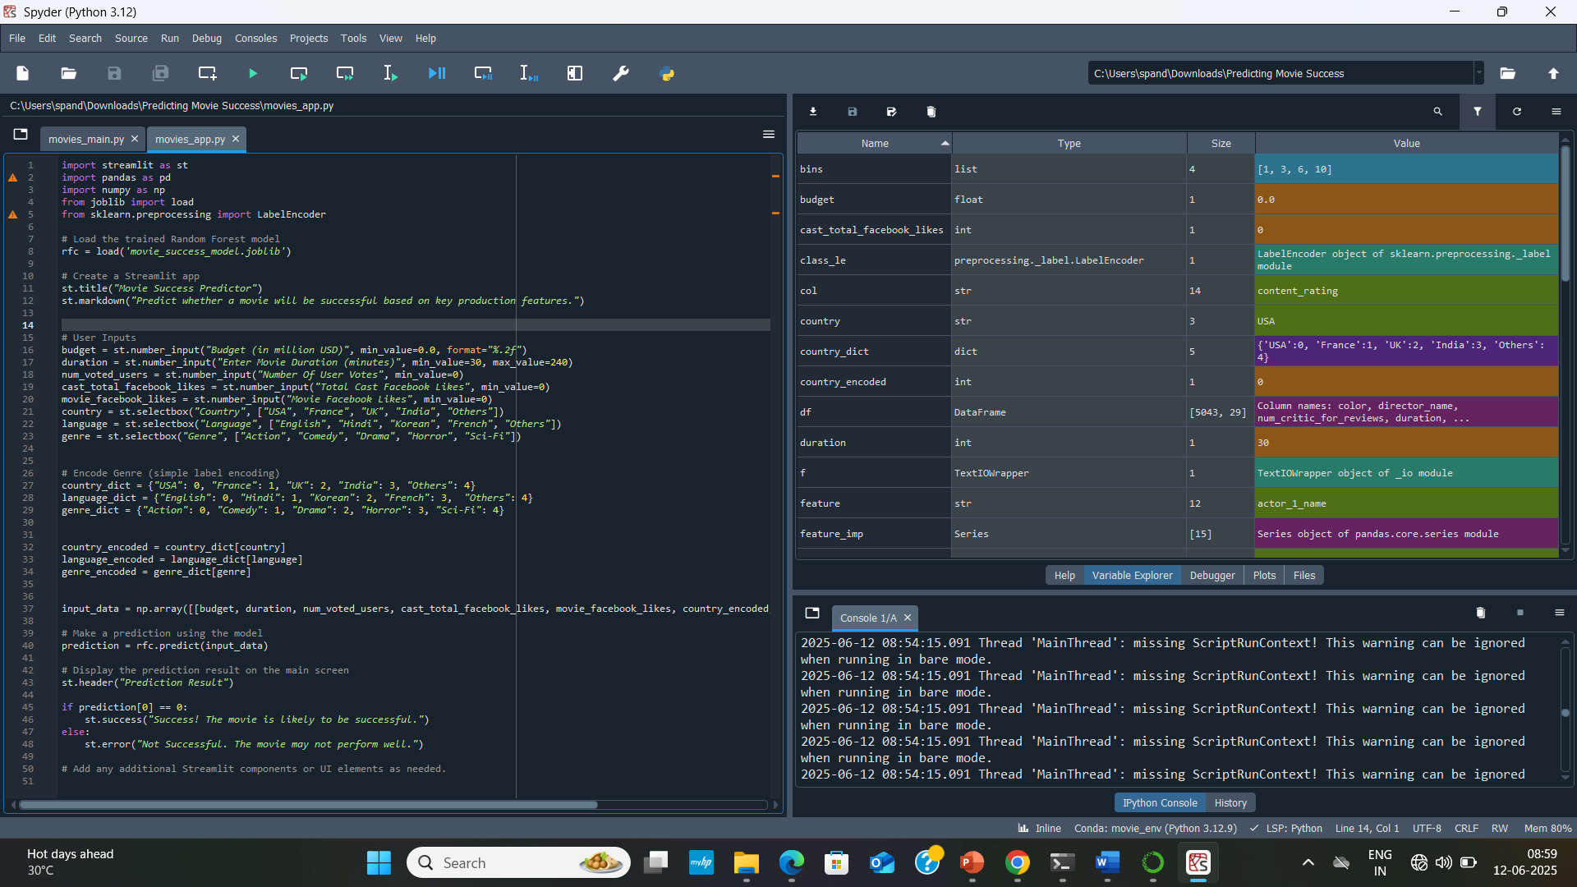

Slide 31
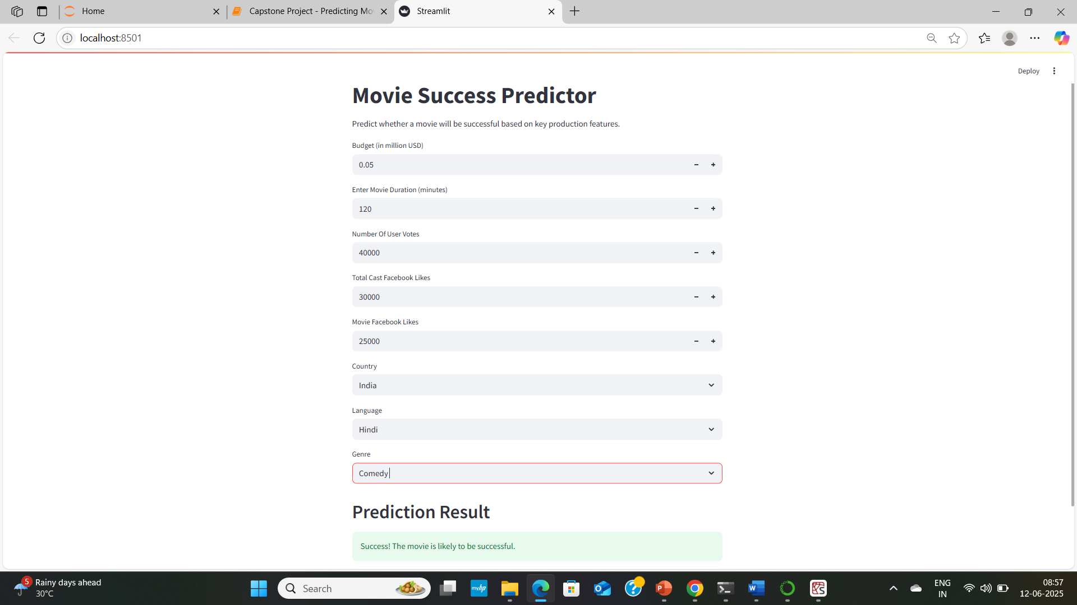
Live Demonstration :
Movie Success Predictor App
Real-time prediction using our trained machine learning model.
Inputs: Budget, Duration, Votes, Country, Language, Genre.
Output: Whether the movie is likely to be successful or not.

Slide 32
Questions ?

Slide 33
Thank You!

